Slide 1
Topics on efficient sampling
Prepared by Sun Dajun dsunad@connect.ust.hk

Slide 2
1.Integrating model-free and model-based approaches in reinforcement learning
Key Idea: Integrating model-free and model-based approaches in reinforcement learning. Use a trained model to modify the model-free target.
Model-based approaches are less accurate but sample-efficient
Model-free approaches are accurate but sample-inefficient(in our case using temperal difference(TD) targets)
In model-based value expansion(MVE):Rolling the learned model out for H steps and use T_H as trainig target
In stochastic ensamble value expansion(STEVE):Use weighted values from a single rollout of H timesteps T_0, T_1,...,T_H as target
Reference: https://papers.nips.cc/paper/8044-sample-efficient-reinforcement-learning-with-stochastic-ensemble-value-expansion.pdf

Slide 3
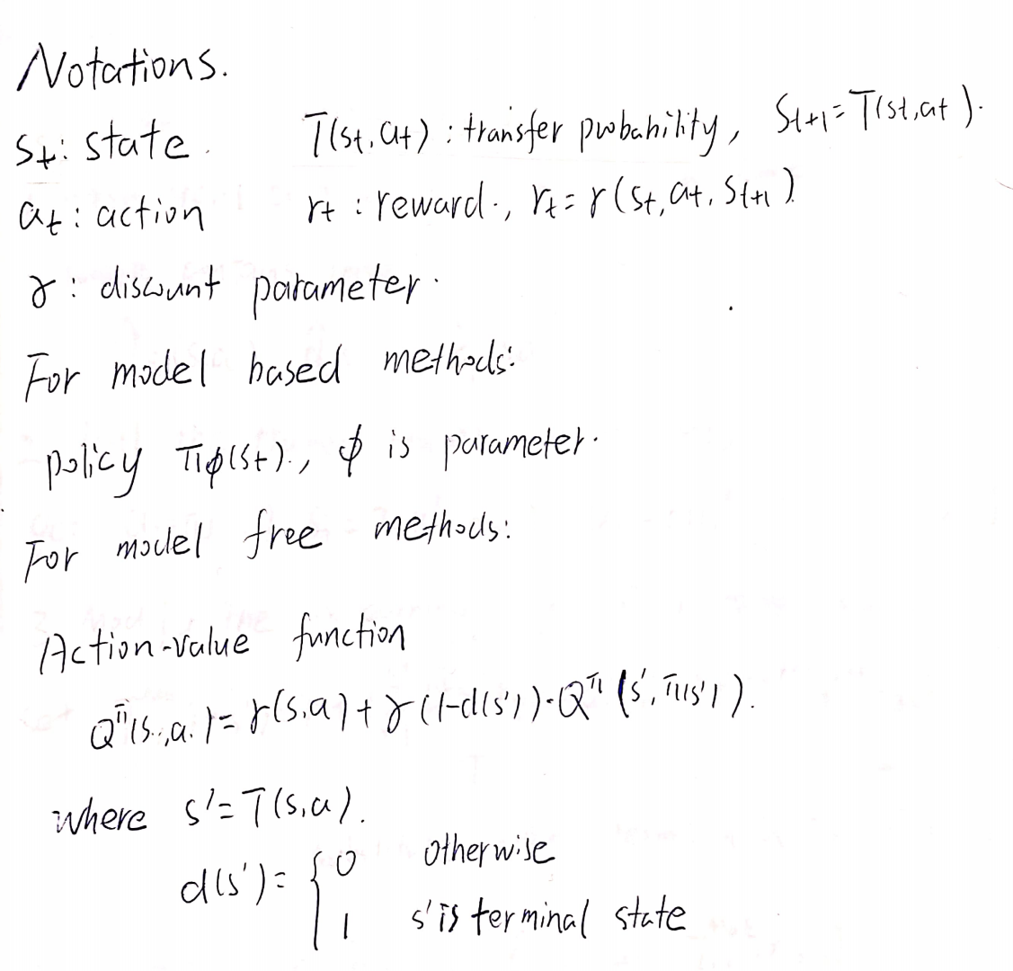
Notations and backgrounds

Slide 4
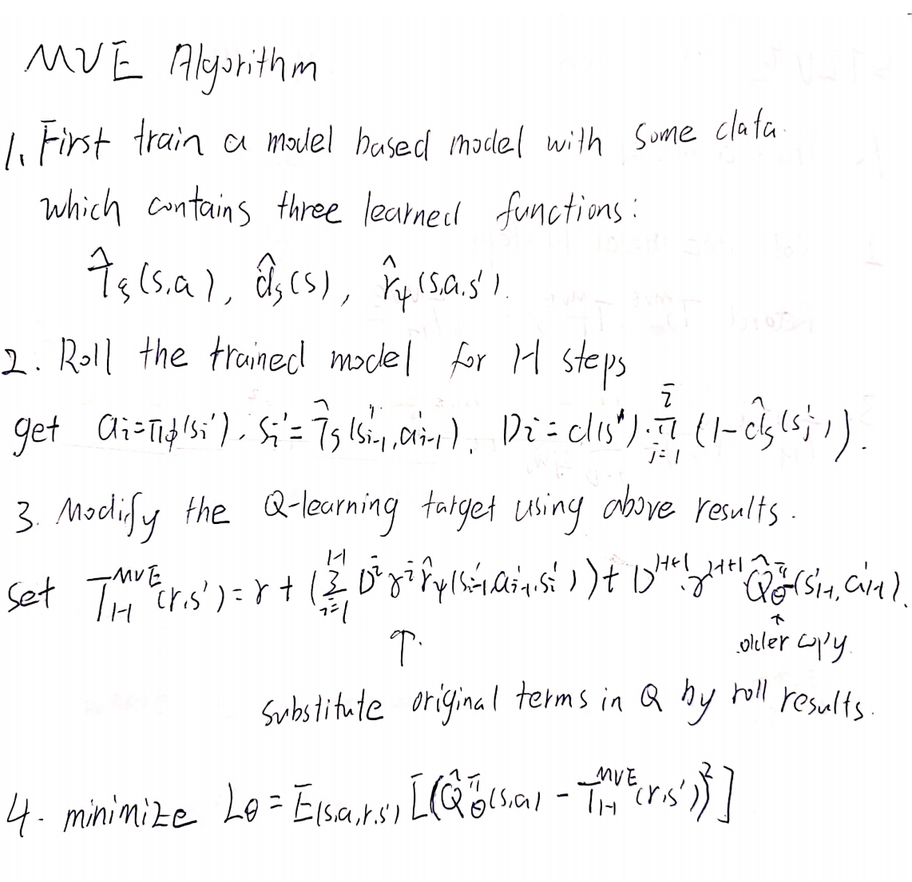
Model-based Value Expansion(MVE)

Slide 5
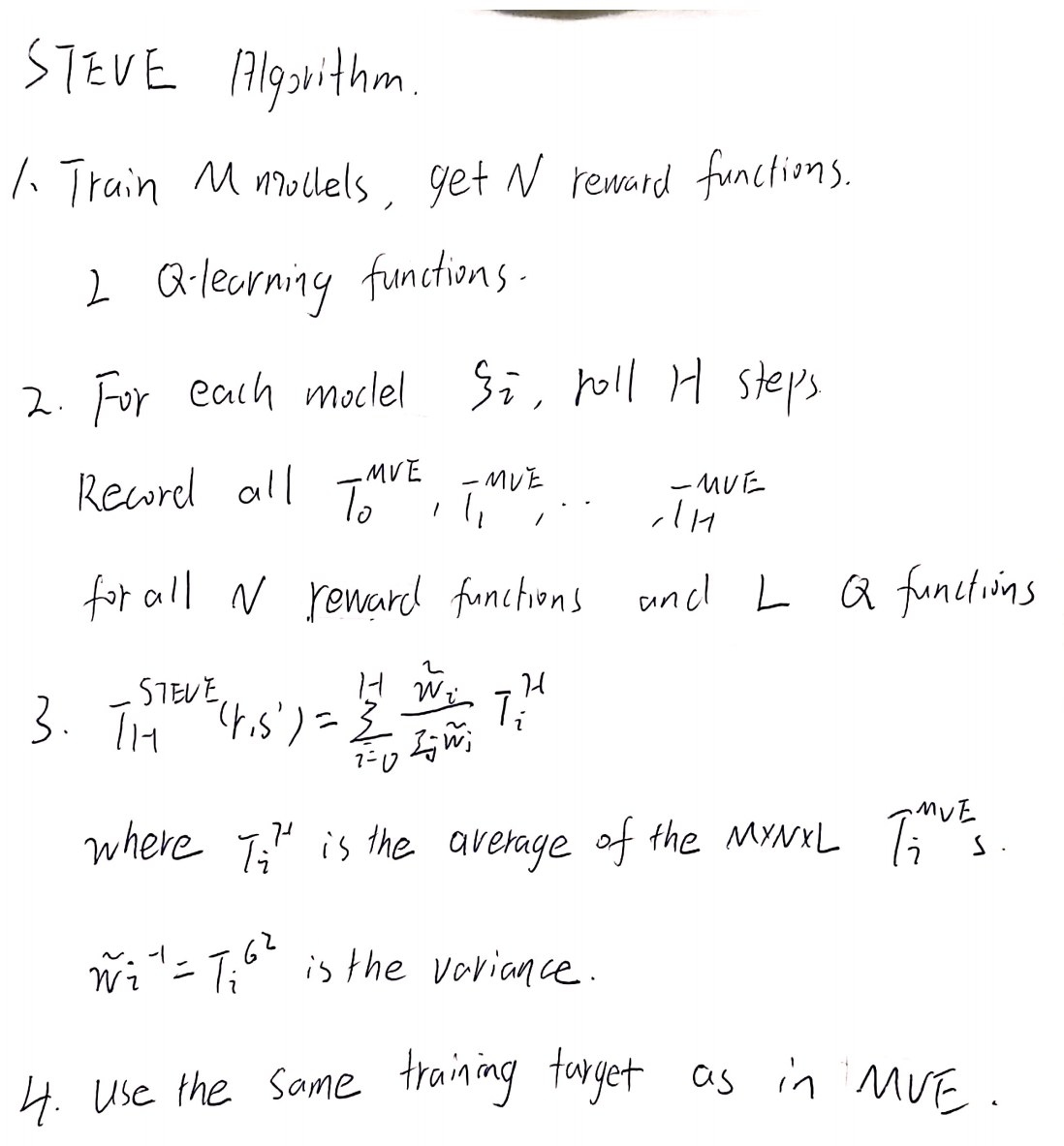
Stochastic Ensamble Value Expansion(STEVE)

Slide 6
2.New Subsampling Algorithms for Fast Least Squares Regression
Key idea: Using both sampled and unsampled data to get double estimation
First use random subsampled data to estimate w0 and get w1, then use remaining data to estimate the error (w0-w1）and get w_correct, final estimation will be w1+w_correct
For fixed setting design matrix, need to precondition it using the randomized hadamard transform matrix
Reference:https://papers.nips.cc/paper/5105-new-subsampling-algorithms-for-fast-least-squares-regression.pdf

Slide 7
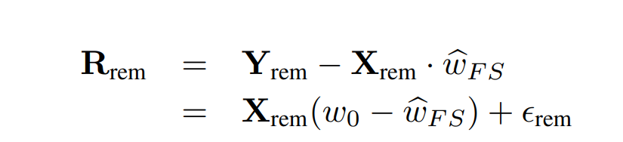
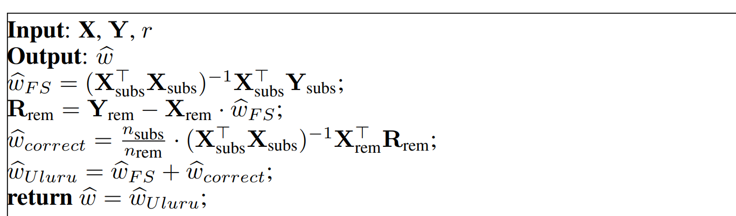
Algorithm
For linear model:Y = Xw0 + epsilon
1. Use r-subsampled (X, Y) to get initial estimate of w0, denoted as w_FS
2. Use the remaining data to estimate w0-w_FS, denoted as w_correct,
since the following holds
3. Add the two estimations together to get the final estimation, algorithm as follows

Slide 8
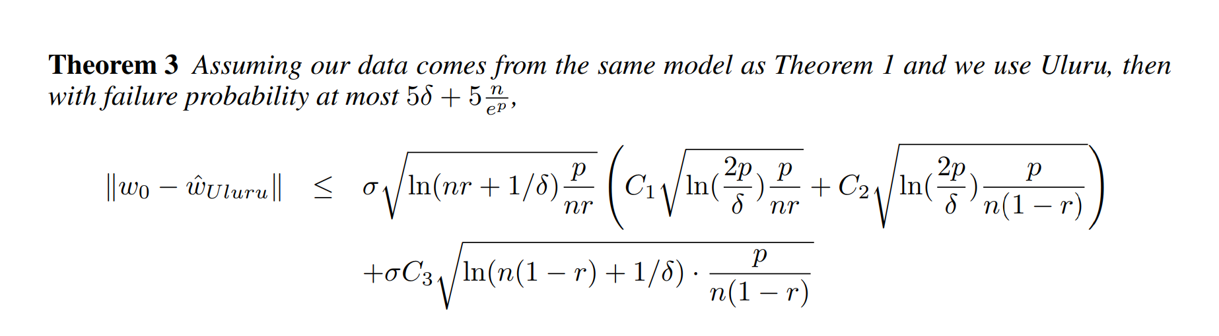
The accuracy of this method is shown to satisfies
For fixed design setting X that satisfies the following condition

Slide 9
3.Dynamic Sentence Sampling for Efficient Training of Neural Machine Translation
Key Idea: Assign weights to each sample to avoid sampling the well-learned sentences repeatly
A weight is assigned to each sentence based on the measured difference between the training costs of two iterations
In each epoch, a certain percentage of sentences are dynamically sampled according to their weights
Reference: https://www.aclweb.org/anthology/P18-2048.pdf

Slide 10
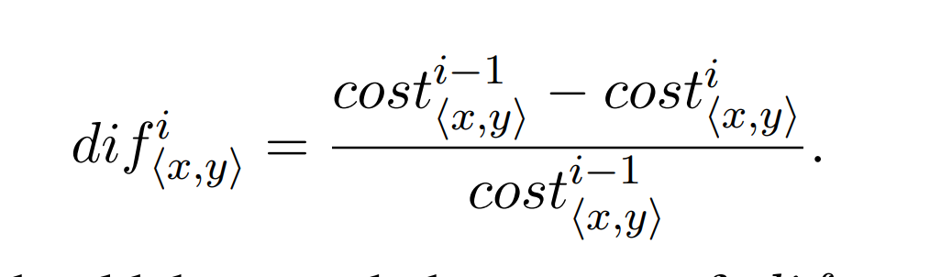
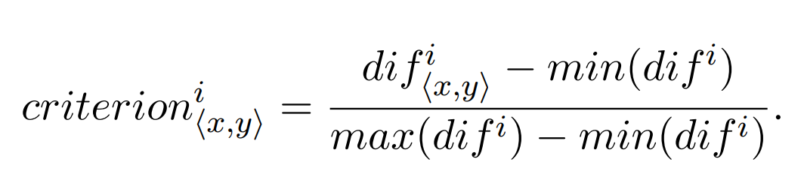
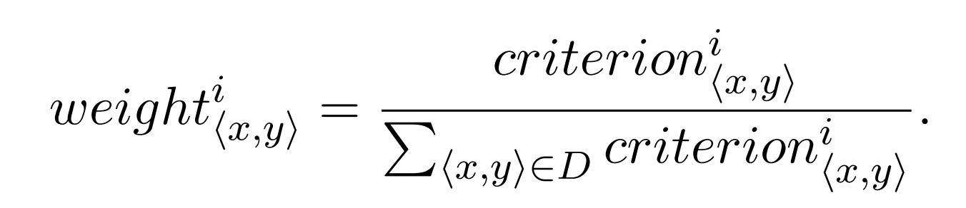
The weight are assigned as follows
Divided by cost_xy in case that after many epoches the cost may betoo small
Normalize to [0,1]
Make all probability sum to 1

Slide 11
4.Efficient sampling of training set in large and noisy multimedia data
Key idea: Based on a simple distance measure that compares the histograms of the sample set and the whole set in order to estimate the representativeness of the sample.
To sample large and noisy multimedia data
Full text not available, I just read the abstract but this method seems to be simple
Rererence: https://dl.acm.org/doi/10.1145/1236471.1236473

Slide 12
5.Sample selection bias correction
Training sample is always biased, when using biased sample, weights should be assigned to correct bias
Key idea: When using frequency estimation to re-weight the training smaple, the bias of training error is bounded
The above results applies to distributionally beta-stable learning algorithms, for example, kernal methods
Details of the proofs are not provided
Reference:https://arxiv.org/pdf/0805.2775.pdf

Slide 13
6.Loss-propotional subsampling for subsequent ERM
Key idea: A requirement on minimum subsampling probability should be satisfied in order to limit the difference between subsampled emperial risk and optimal true risk
A brief introduction is shown in next page
Reference:https://arxiv.org/pdf/1306.1840.pdf

Slide 14
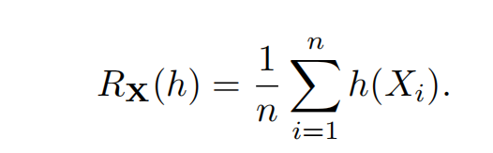
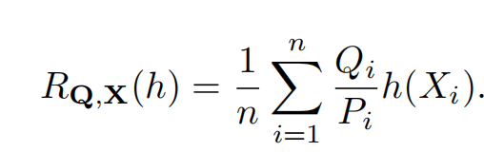
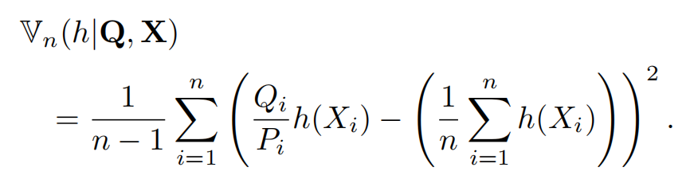
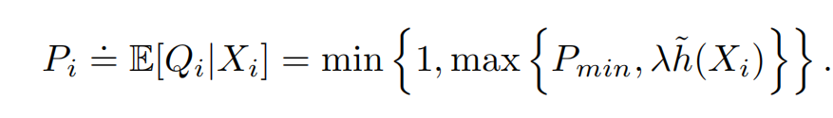
Using 0-1 loss, the emperical risk is expressed as
After subsampling, the risk is modified to
where Qi ∈ {0, 1} is a random variable indicating whether or not Xi is included in the subsample, and Pi = E[Qi|X] is the sampling probability.
The deviations between R_{X}(h) and R_{Q,X}(h) are driven by the emperial variance:
And since h<=1, the variance V_{n}<=1/(min_{i} P_{i})R_{Q,X}(h)
Choose Pi that satisfies
Then the deviation is bounded

Slide 15
7.Local uncertainty sampling for large-scale nulti-class logistic regression
Key idea: Following the concept of local uncertainty sampling, design smart acceptance probability function and training target to improve subsmpling performance
Using this method, many different acceptance probability functions can be used
Also it comes with naturally regularization
Reference: http://tongzhang-ml.org/papers/aos20-lus.pdf

Slide 16
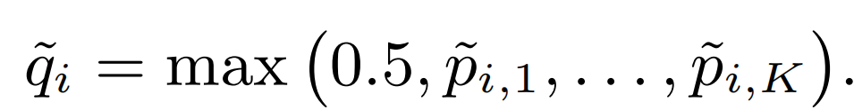
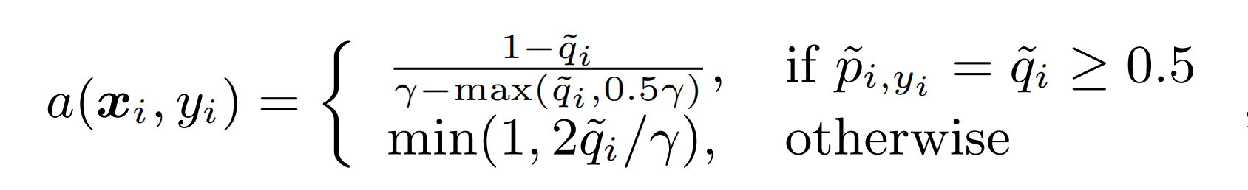
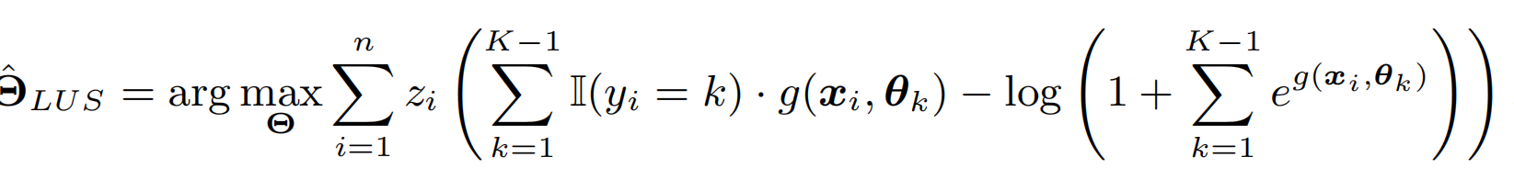
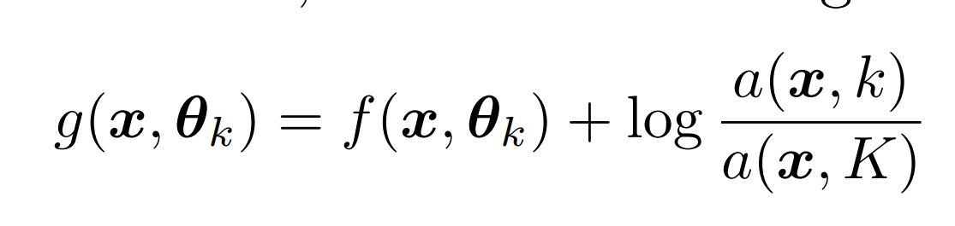
Algorithm
1. Choose a parameter γ which determines the subsampling size
2. Get a pilot estimator λ to estimate p_{i,k}=Prob(Y=k|X=x)
3. Define qi as
Then set the acceptance probability function as
For each i, generate zi~Bernoulli(a(xi, yi)), keep the samples with zi=1 as training sample
4.Fit a multi-class logistic regression model to the subsample set {(xi, yi) : zi = 1} with the following target
where g(x, θ) is defined as
And then output Θ^_{LUS}

Slide 17
Remarks
The proposed training method generates a consistent estimation of the parameter without post-estimation correction, which makes different acceptance probability functions appliable to this algorithm
It also has a good performance when the model is misspecified
For two-class case, if λ is consistent to the true Θ, then so does Θ^_{LUS}
For multi-class case, it still has good performance

Slide 18
Two categories of approaches to improve sample efficiency
Subsample the original sample set smartly to remain as possible as more information
For example: paper 3,4 and 7
Modify learning algorithms to utilize sample better
For example: paper 1,2

Slide 19
Some experiments
I tried to reproduce the LUS method in both linear regression context and deep learning context
In each context, I tested the performance of the sampling method
Also I tested the importance of the corrected learning target
Additionally I tried the sampling method in other learning methods, for example: CNN for classification using softmax loss function
All codes are shown in https://github.com/dsunad/Local-Uncertainty-Sampling-Reproduction

Slide 20
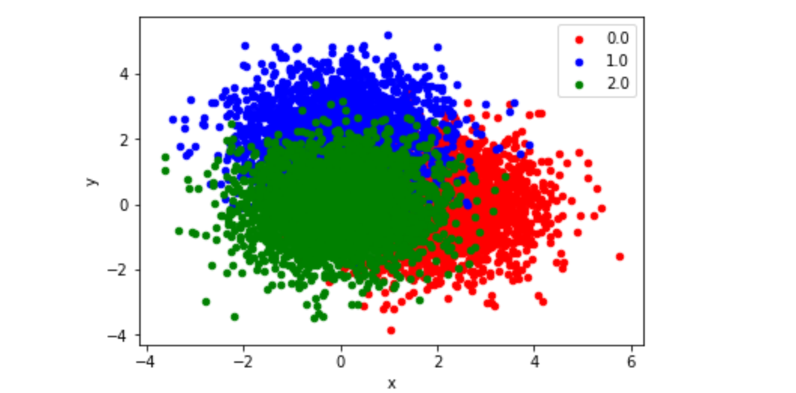
Linear Logistic regression
In the first experiment, I tested the LUS method using simulated Gaussian-distributed data(3 classes, 10 dimensions) in both marginally balanced case and imbalanced case. For all classes I used the identity matrix as covariance matrix, and the mean vector for each class is:
mu_1 = (2,2,2,2,2,0,0,0,0,0)
mu_2 = (0,0,0,0,0,2,2,2,2,2)
mu_3 = (0,0,0,0,0,0,0,0,0,0), attached is a graph showing the 1st and 6th dimension of the simulated data points.

Slide 21
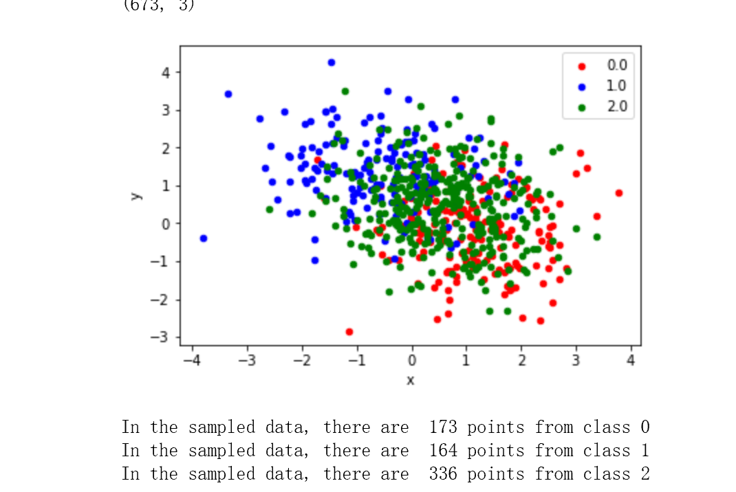
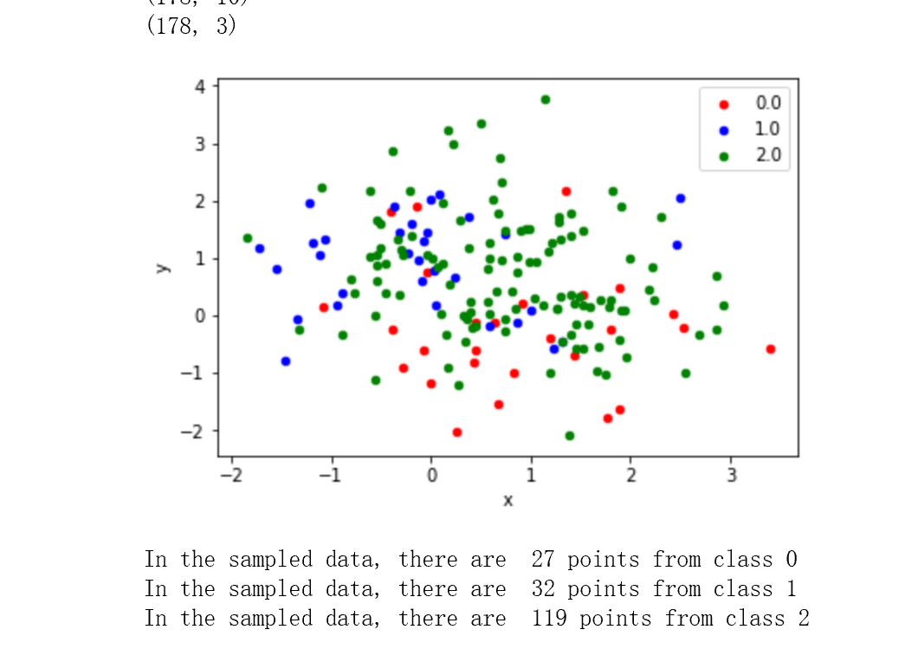
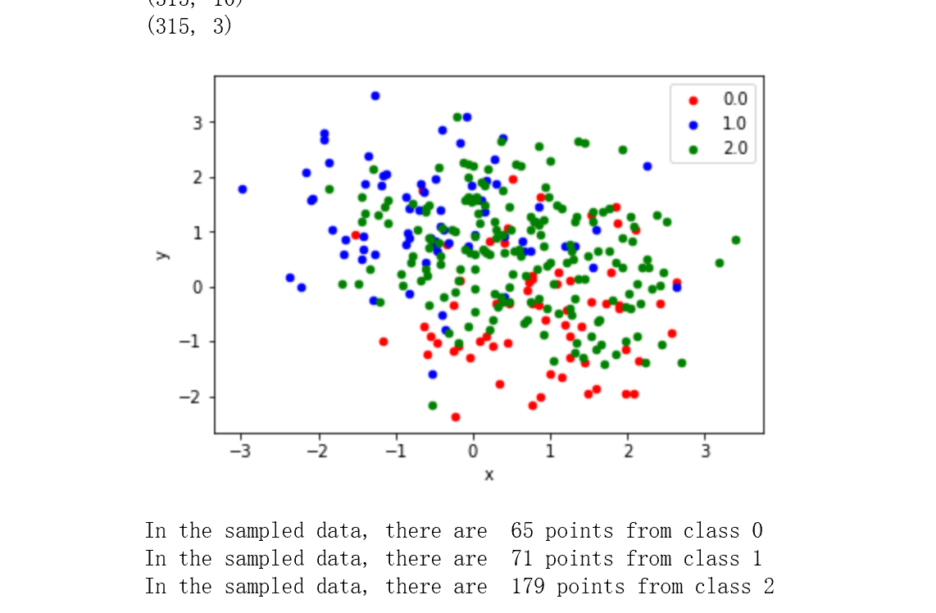
Marginal Balanced Case
First I tested the marginal balanced case, with total point n = 9000 and each class has 3000 data points
I used a pilot sample containing 1500 uniformly subsampled points to pre-train the logistic model, then LUS is performed several times at gamma = 2
I noticed that the sampled points are imbalanced(more green points), and the number of sample is highly varianced
Also the sampled data are more “distinguished”, therefore contains more usful information

Slide 22
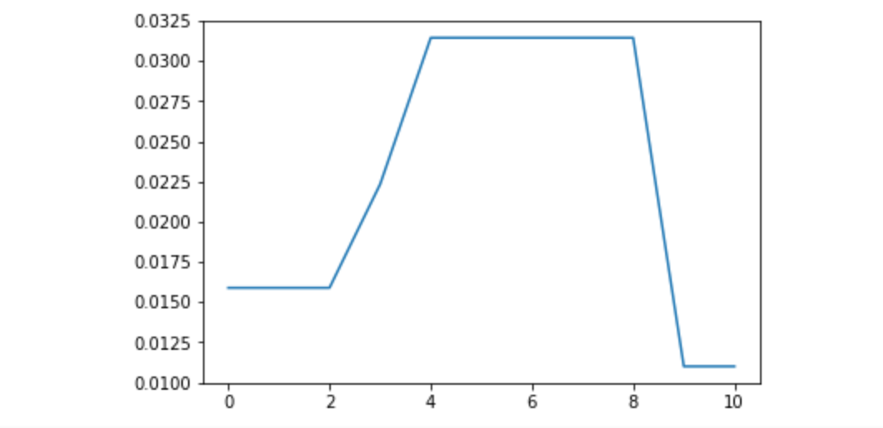
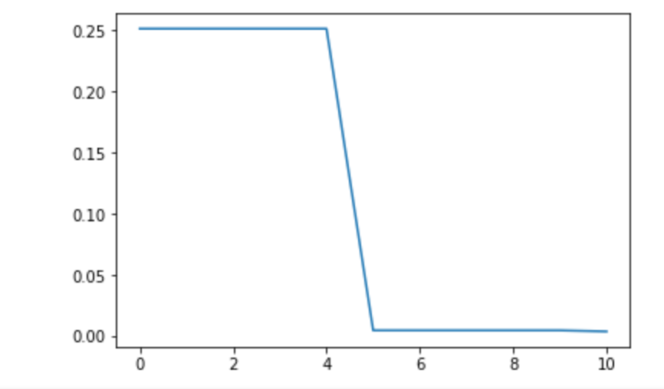
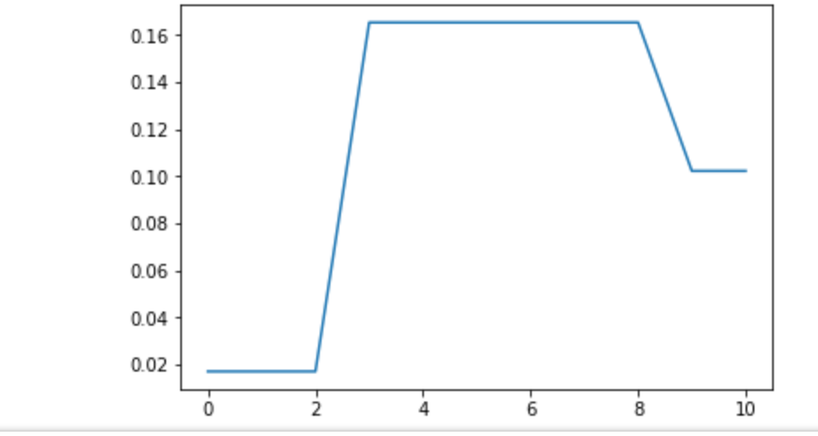
As shown in the previous slide, the number of samples is highly varianced, this slide gives a more detailed analysis of this fact
First I performed LUS at gamma = 2 for 30 times and plotted the fraction of sample number compared to 9000
1. The fraction of sampled points is always far from the theoretical bounds, which is 1/gamma, this may due to the good performance of the pilot classifier(more than 97% accuracy)
2. The sample number is highly varianced and hard to control, sometime even fall to zero

Slide 23
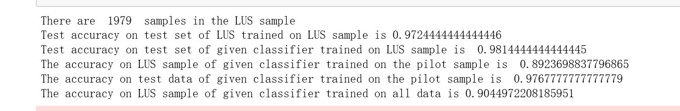
Above is one training result, using 1979 LUS sampled points
Line 4&6 shows the low accuracy on the LUS sampled data points, indicating they are more special
On average, classifiers trained on LUS sample has a better performance(0.981) than trained on all data points(0.976), using a smaller set of data
Also I found that the modified training target, namely adding a(x,i)/a(x, K) weights doesn't play a significant rule, since the normal target used in the given logistic regression in the sklearn package also has a good performance

Slide 24
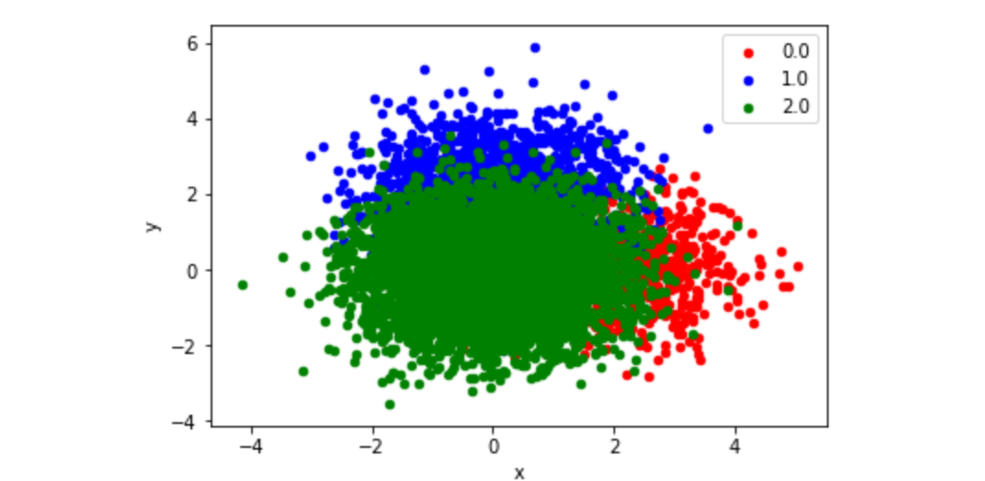
Marginally Imbalanced Case
Let n = 9000 is the total number of points unchanged, this time let the fraction of class 1 to be 0.1, fraction of class 2 to be 0.2 and fraction of class 3 is 0.7
Other things remains unchanged, attached is the graph of the whole dataset

Slide 25
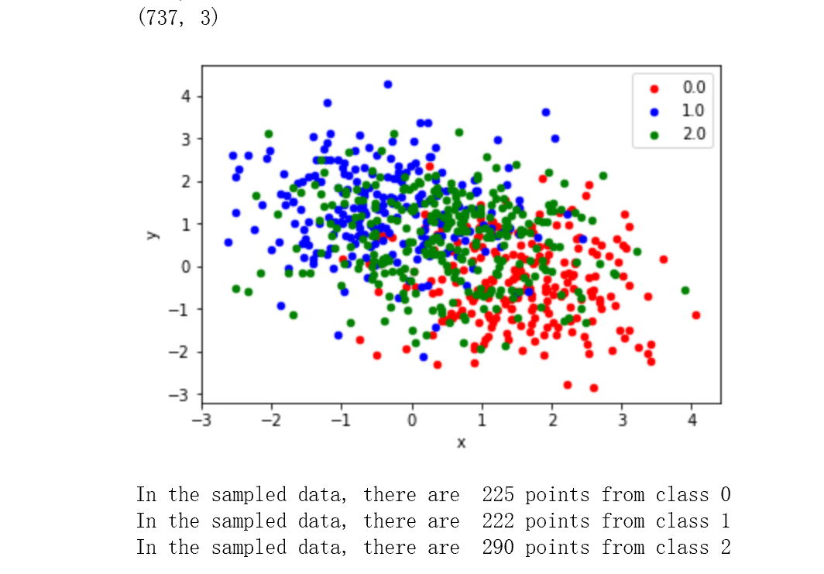
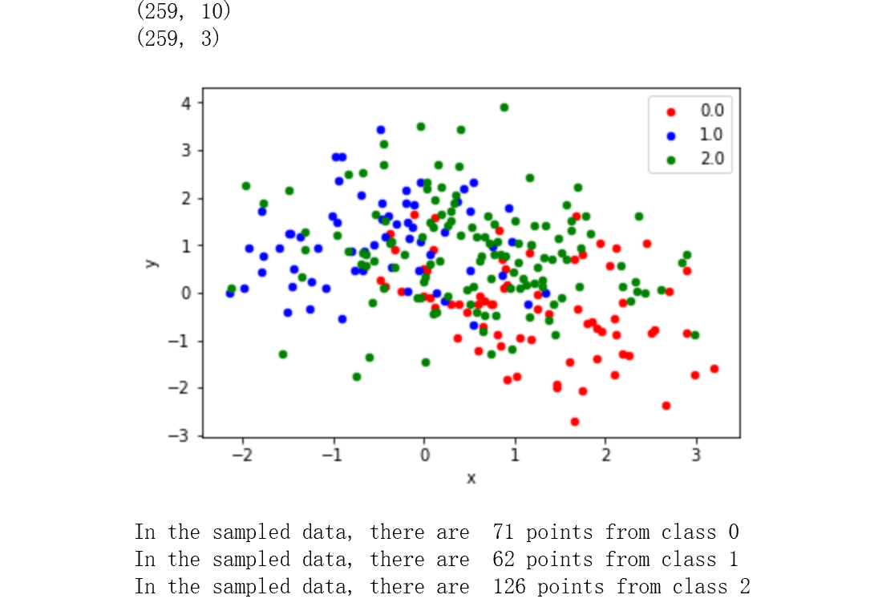
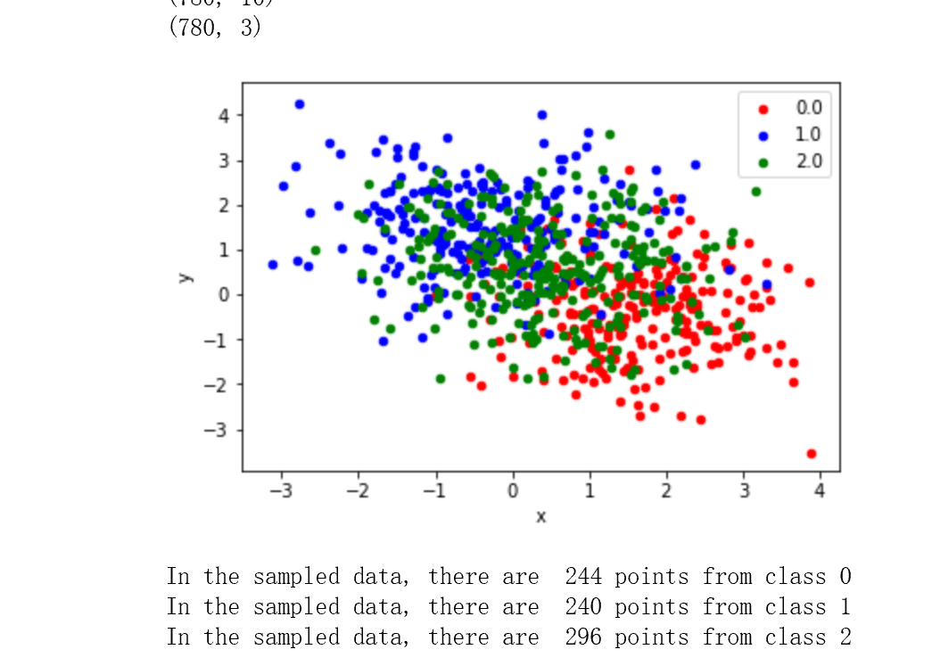
As shown below, LUS method generates a relatively balanced dataset compared to the original fraction (0.1, 0.2, 0.7)
The sampled points are still more “distinguished”

Slide 26
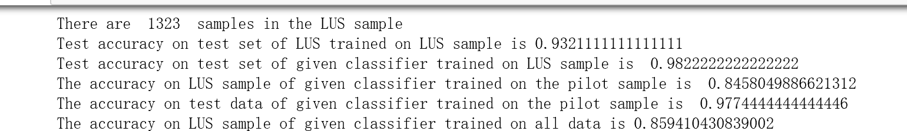
I got similar training results as in previous case, the performance on LUS sample is still slightly better
The second line of accuracy 0.93 is because my own algorithm implementation is not efficient, it takes a lot of time to converge... In this situation, it doesn't converge to the optimal
Again the modified training target is not quite important

Slide 27
Conclusion
In both marginally balanced or imbalanced case, the LUS method successfully chooses those more important data points, and therefore gives better performance
The modified target is not important since the accuracy of my algorithm and the sklearn logistic regression are similar
In marginally imbalanced case, LUS sample re-balances the data
Sample number is not stable

Slide 28
Logistic Regression using CNN
In deep learning context, I used the common MNIST dataset, which is marginally balanced
The network architecture is the one given in https://zhuanlan.zhihu.com/p/30911463
Different from Prof Zhang's paper, I used a linear model trained on the validation sets as the pilot classifer
I did three main special experiments: 1. Use A = np.ones to see whether the modified target is useful. 2. Use the LUS asmple to train a softmax network. 3. Compare the performance of LUS sample and uniform sample

Slide 29
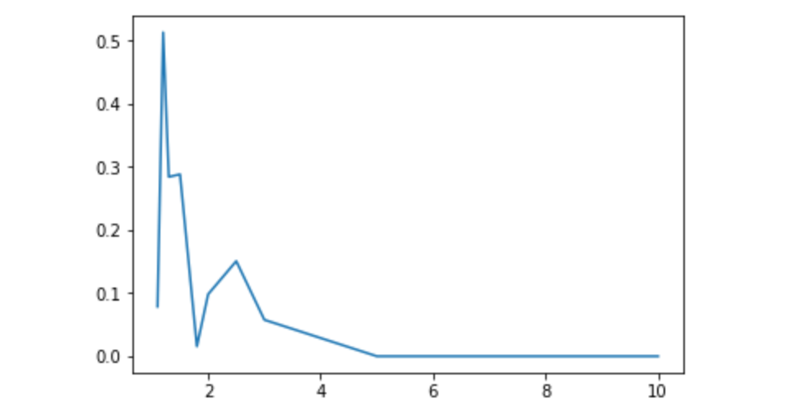
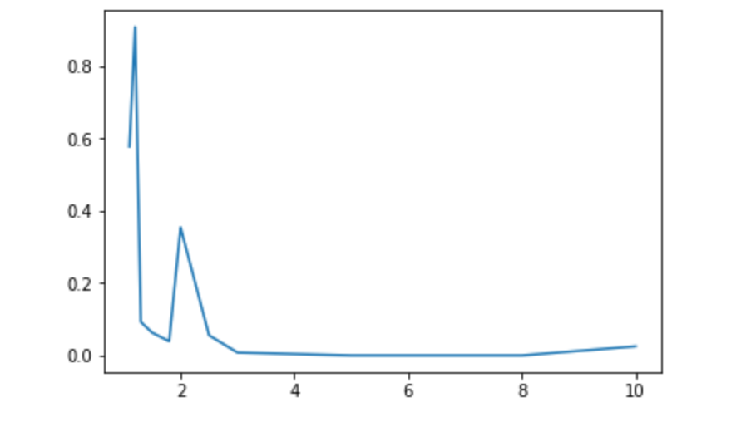
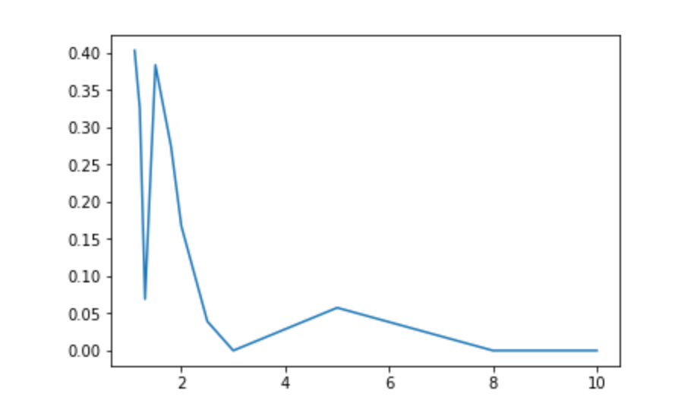
Before starting, I first tested the change of sample fraction w.r.t gamma, I used gamma in [1.1, 1.2, 1.3, 1.5, 1.8, 2, 2.5, 3, 5, 8, 10] and got several graphs shown below(x axis is gamma)
In genral, sample number decreases as gamma increases, which consists with the paper
Still for each gamma, sample number is highly varianced(not shown)

Slide 30
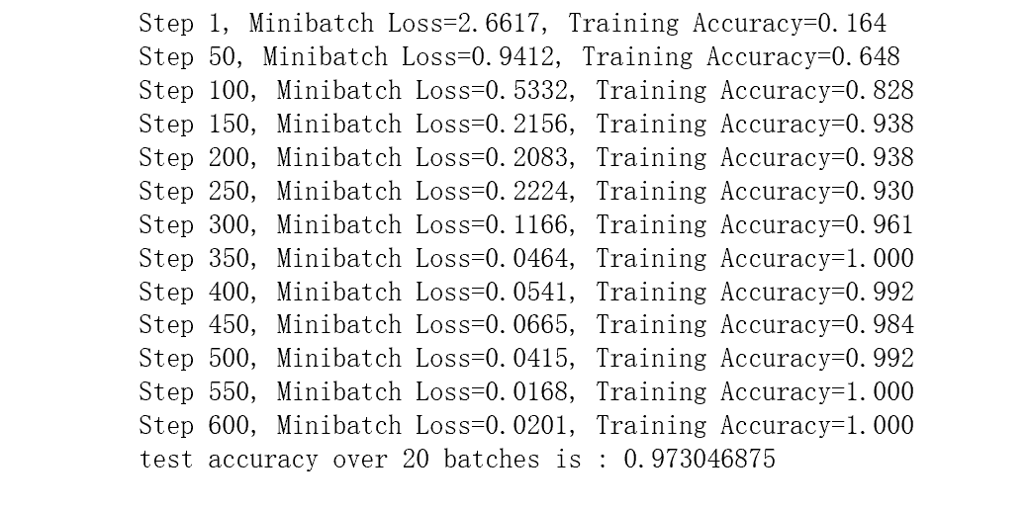
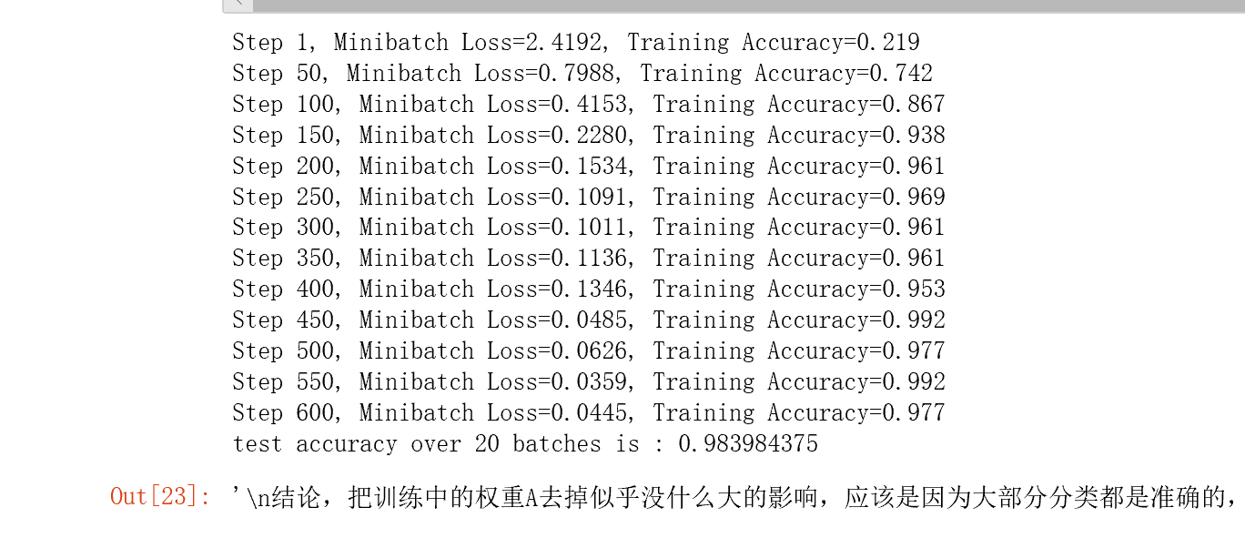
1.Use A = np.ones
The left graph shows a model trained on the correct A while the right one is a model train on A = np.ones(num_classes, n), which has even higher accuracy
This may because for the MNIST set, predict accuracy is quite high on average so the weight is not too useful since the only correct class donimates the probability, this feature is appliable to other loss functions such as softmax
Conclusion: A is not really important when accuracy is high

Slide 31
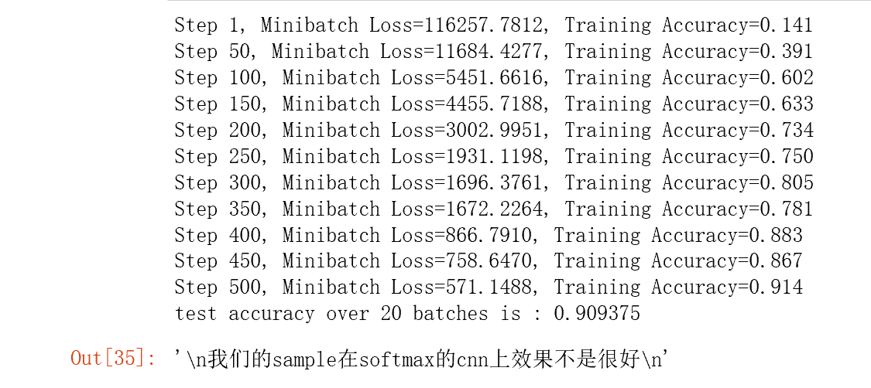
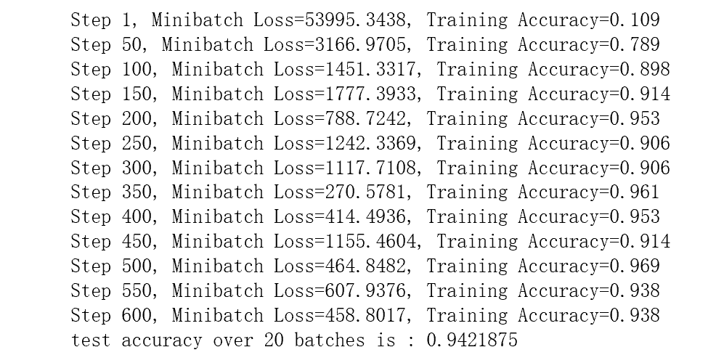
2. Use LUS on Softmax Network
Left: softmax CNN trained on LUS sample, Right: softmax CNN trained on whole train data
Conclusion: Our LUS method is not appliable to softmax network, note that this is possiblely due to our choice of pilot model

Slide 32
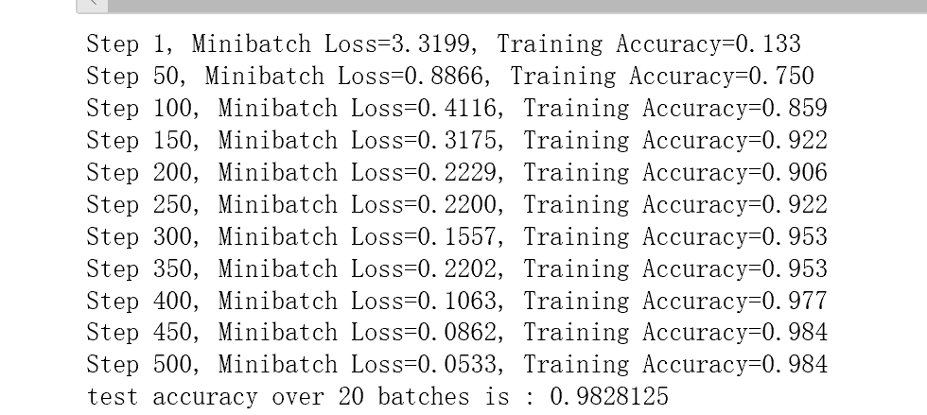
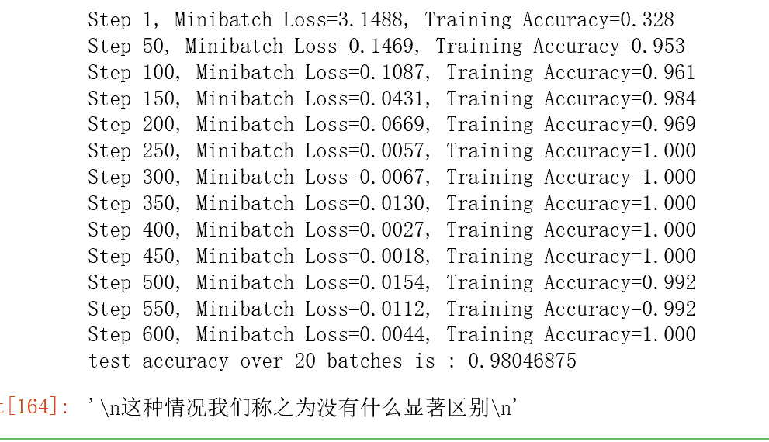
3. Compared with Uniform Sample
The left model is trained on LUS sample, right one trained on uniform sample
Conclusion: Not significant difference in such marginal balanced case

Slide 33
Summary
The weight in the modified target seems to be unimportant, therefore the sampling method may be also applied in models such that the correct target are not easy to be specified
The parameter gamma describes a upper bound, but cannot control the sample number precisely
LUS may be sensitive to model selection, say, when both pilot and main model are logistic model, performance is good, when the main model is based on softmax, the performance is not satisfying

Slide 34
Possible topics to work on
Try to derive good acceptance probability functions
Try to apply LUS to deep learning
Theoretical analysis on how a specific subsampling method affect training result, say, try to bound the difference theoreticallly
Try new samplig methods in different fields
Investigate how (different) pretrained models affect the later subsampling results

